Slide 1

2013 PCRTA Scholarship Winners

Slide 2

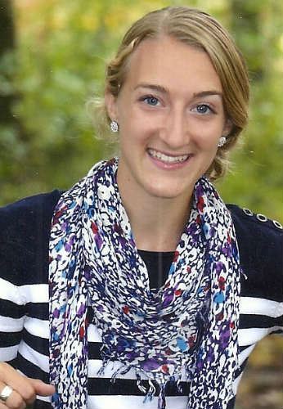
Sarah Mc
Sarah McClure
Theodore Roosevelt High School
Intended major:
Elementary Education or Spanish Education
Bowling Green State University

Slide 3
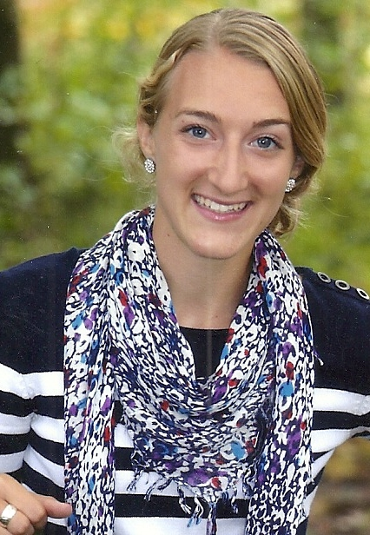
Sarah McClure
Activities:
Sports: Track, Cross Country
Clubs: Choir, National Honor Society, Student Council
Leadership: Team Captain in Track, Camp Counselor
Volunteer and Outside Activities: Worked with Mentally Adults, Mission Trips, Sunday School Teacher

Slide 4
Sarah McClure
“Regardless of which teaching path I choose, Elementary or Spanish, I am extremely excited to become a teacher and sincerely hope to have a profound impact on the lives of my students.”

Slide 5

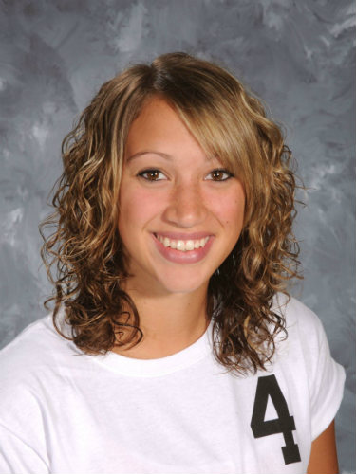
Alexa Brewster
Streetsboro High School
Intended major:
Athletic Training and Physical Education
Kent State University

Slide 6
Alexa Brewster
Activities:
Sports: Volleyball Ist Team all District 3 yrs., 1st Team all PTC 3 yrs.
Clubs: Student Council, National Honor Society, Spirit Club President
Leadership: Volleyball Captain 4 yrs.
Volunteer and Outside Activities: Community Christmas and Volleyball For the Cure

Slide 7
Alexa Brewster
“I plan to take full time rigorous courses of academics and reach my goal by focusing strongly on my studies and earning good grades.”

Slide 8

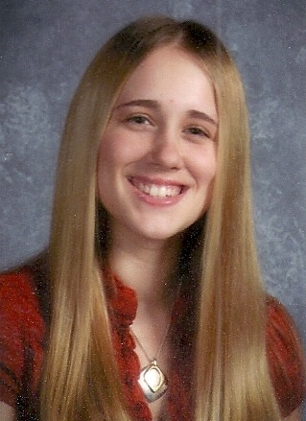
Samantha Cooper
Field High School
Intended major:
Early Childhood Education and Intervention Specialist
Mount Union

Slide 9
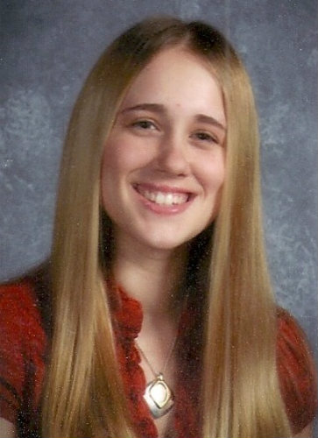
Samantha Cooper
Activities:
Clubs: National Honor Society, Student Council, Teen Institute, and Drama Club
Leadership: Valedictorian, Student Advisory Board for the School Levy
Volunteer and Outside Activities: Mission Trips, Junior Achievement Instructor

Slide 10
Samantha Cooper
“Ever since I was a little girl, I have wanted to be a teacher.”

Slide 11
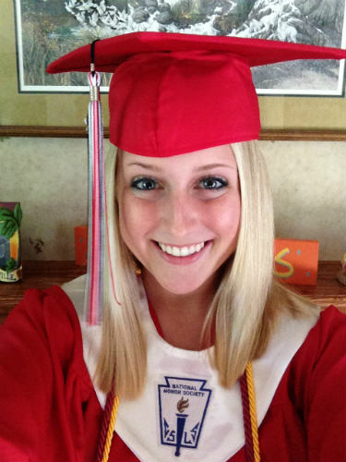
Melody Smith
Field High School
Intended major:
Vocal and Instrumental Music
Kent State University

Slide 12
Melody Smith
Activities:
Clubs: Choir, Drama and Band
Sports: Tennis
Leadership: National Honor Society, President of Field Concert Choir
Volunteer and Outside Activities: Professional Magician, Community Music Organizations

Slide 13
Melody Smith
“I want to be able to share my love of music with adults and children alike.”

Slide 14

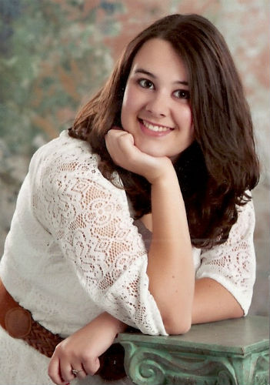
Ashley Spangler
Waterloo High School
Intended major:
Art Education
Kent State University

Slide 15
Ashley Spangler
Activities:
Sports: Cheerleader and Cheerleader Captain
Clubs: Art Club, Drama Club, National Honor Society, Poetry Club, Color Guard, Lead role in the Wizard of Oz
Volunteer and Outside Activities: Wrestling Statistician and Teacher’s Aide.

Slide 16
Ashley Spangler
“I believe that art changes lives.”

Slide 17
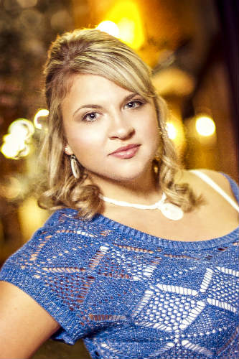
Kayla Tuma
Streetsboro High School
Intended major:
Early Childhood Education
Kent State University

Slide 18
Kayla Tuma
Activities:
Sports: Cheerleader
Clubs: National Honor Society
Leadership: Class President 4 Yrs., Cheer Captain, Spirit Club Officer, Secretary of Student Council
Volunteer and Outside Activities: Community Christmas, Pinwheels for Prevention, Nursing Home Volunteer

Slide 19
Kayla Tuma
“I’m not the average student; I work for what I want. When I have my mind set to do something, I strive to achieve it.”

Slide 20
2013 PCRTA Scholarship
Committee Members:
Jan Fencl
Dave Gynn
Jim Montaquila
Lowell Myers
Norm Park
Kay Wise

Slide 21
Our thanks to Edith Scott and the PCRTA Members who volunteered their time to support the Scholarship Program.

